Slide 1
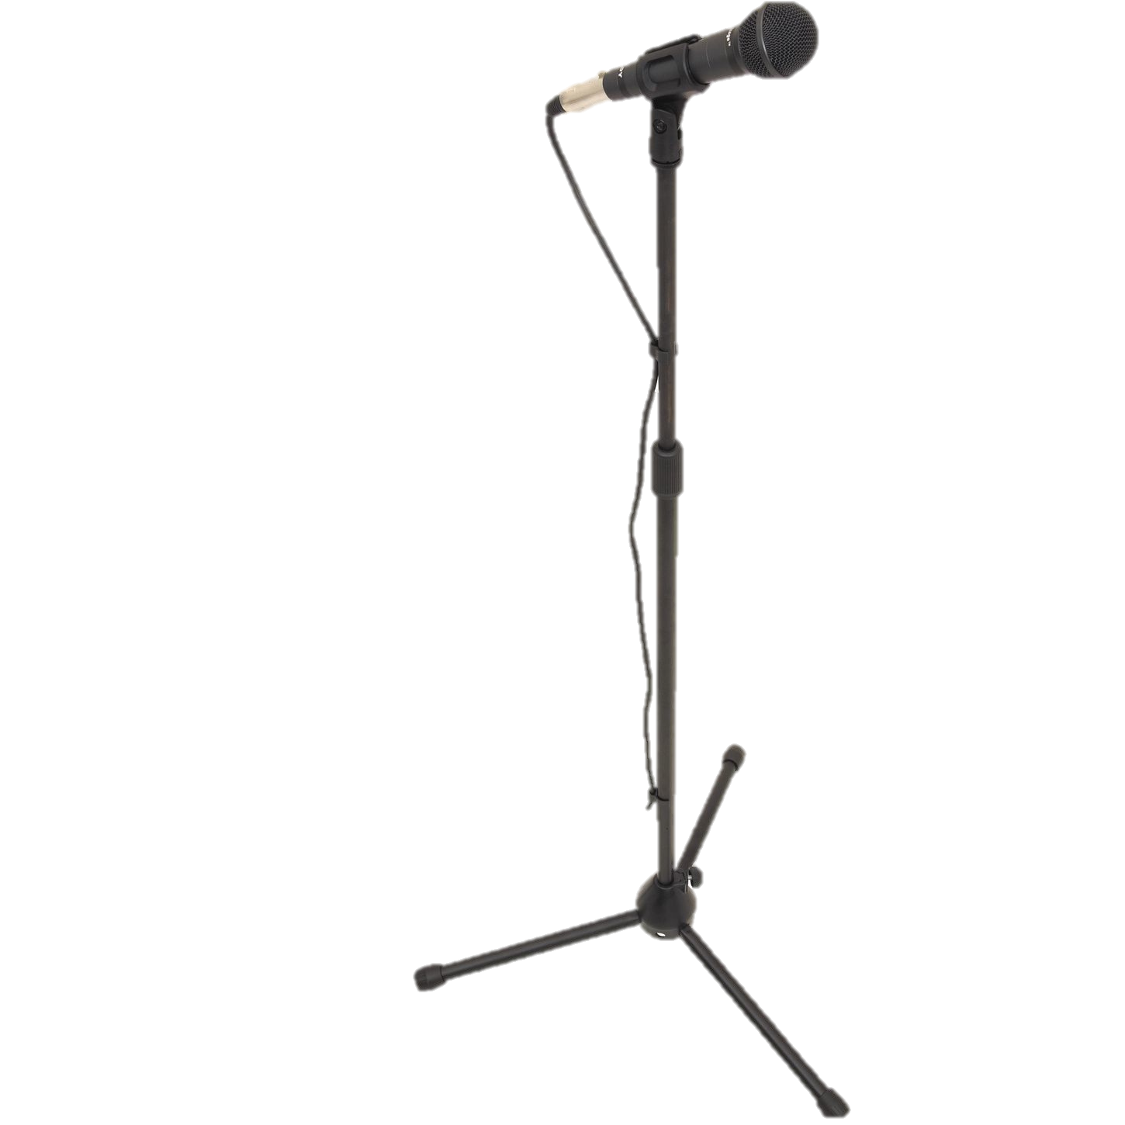
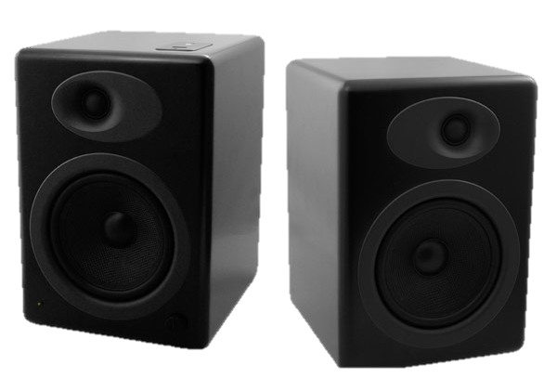
Virtual Sounds for Computer Games
By Ben West

Slide 2
Introduction
Aim: To look into how sound changes in different environments and manipulate it.
Objective: To use frequency response, medium length sequence and other techniques to allow us recreate different audio environments.

Slide 3
Background
The perception of sound in any organism is limited to a certain range of frequencies.
Sound pressure is often measured as a level on a logarithmic decibel scale

Slide 4
Equipment
Microphone
Computer
Speaker
D

Slide 5

Frequency Sweeps
Frequency sweep with the sine waveform start from 20 to 20000 Hz
It covers the lowest frequency to highest frequency that most human ears can detect.

Slide 6
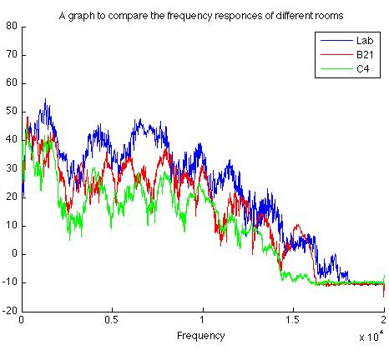
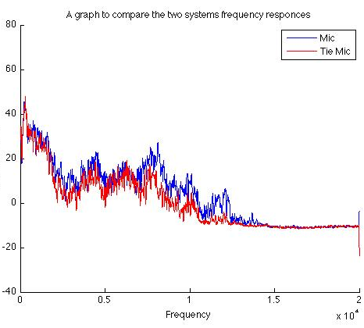
Frequency Sweeps
Compares how the frequency response varies for in different rooms
Compares how the two different microphones used responses vary.

Slide 7
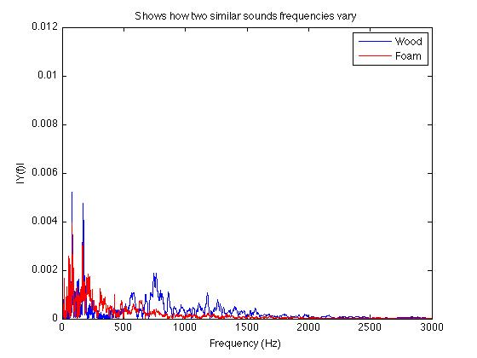
Impact Sounds
Two knocks in the same place of a room. One directly on to wood and another damped by foam.

Slide 8
Impulse Response
Is the output of a dynamic system when presented with a brief input signal (impulse)
Developed in the 1970’s for testing loudspeakers
Enables the acoustic characteristics of a location, such as a concert hall, to be captured.

Slide 9
Future Plans
Convolution Reverb
Maximum Length Sequence
Manipulating Sounds

Slide 10
Summary
Aim: To look into how sound changes in different environments and manipulate it.
Objective: To use frequency response, medium length sequence and other techniques to allow us recreate different audio environments.

